Slide 1
SIMULATIONS AND IMPLEMENTATION OF MAGNETIC MICROGRIPPERS FOR THE REMOVAL OF TEXTILE DYES IN WASTEWATERS

Slide 2
OBJECTIVES AND SCOPE
Simulation and implementation of biomicromechanical devices for the removal of textile dyes from wastewaters.
Specific (Tesis 1)
❖ Select materials and appropriate surface functionalization strategies to conduct textile dyes removal processes from wastewaters.
❖ Engineer the geometry and simulate selected materials with suitable capacity to be implemented in the microstructures.
❖ Use software to simulate magnetic and mechanical responses of the microstructures and interactions among themselves.

Slide 3
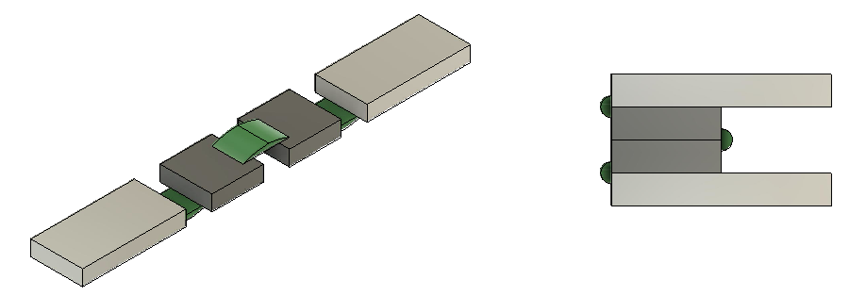
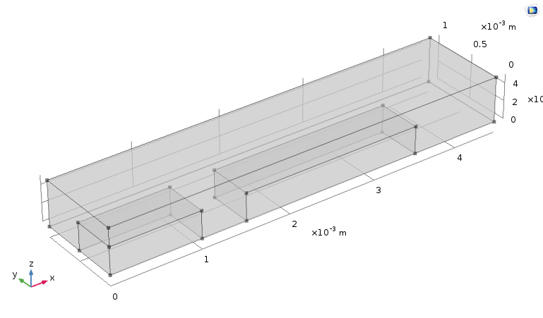
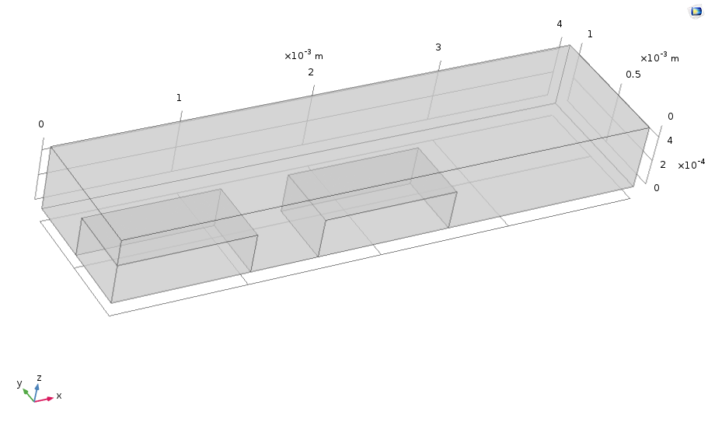
Inicial draft

Slide 4
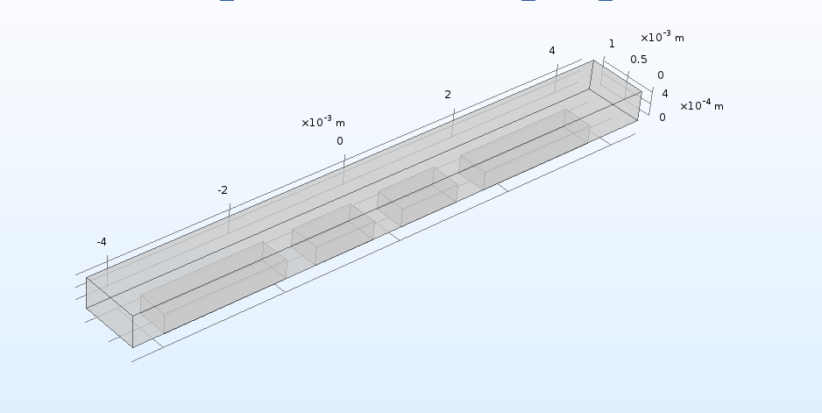
COMSOL

Slide 5
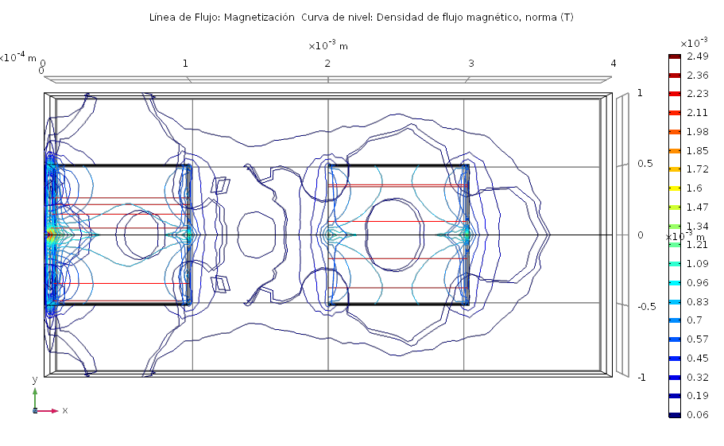
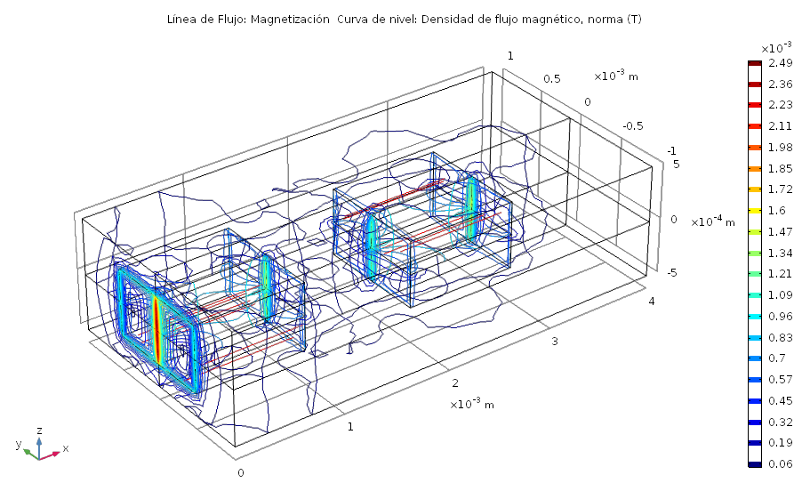
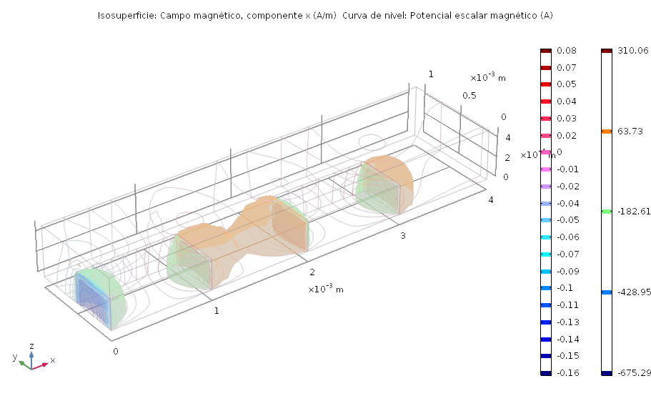
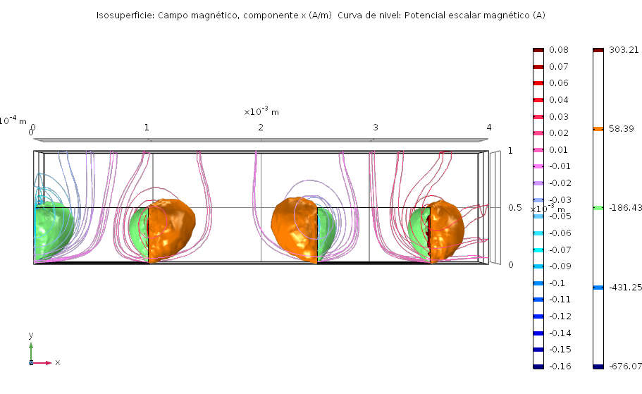
Magnet - Magnet

Slide 6
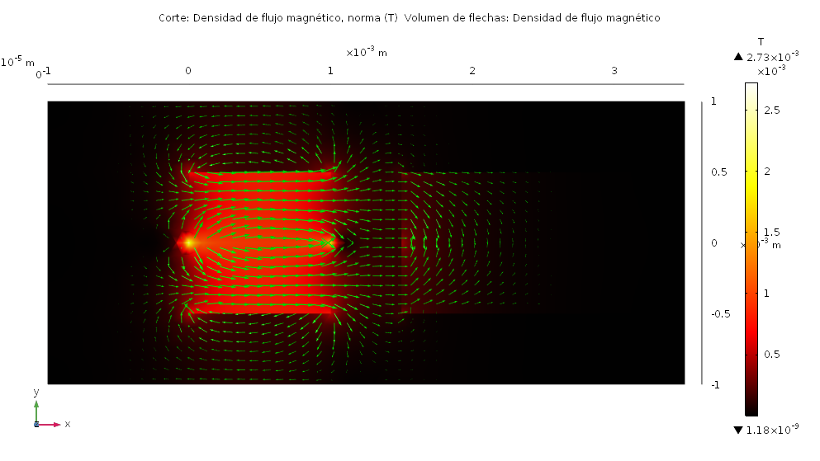
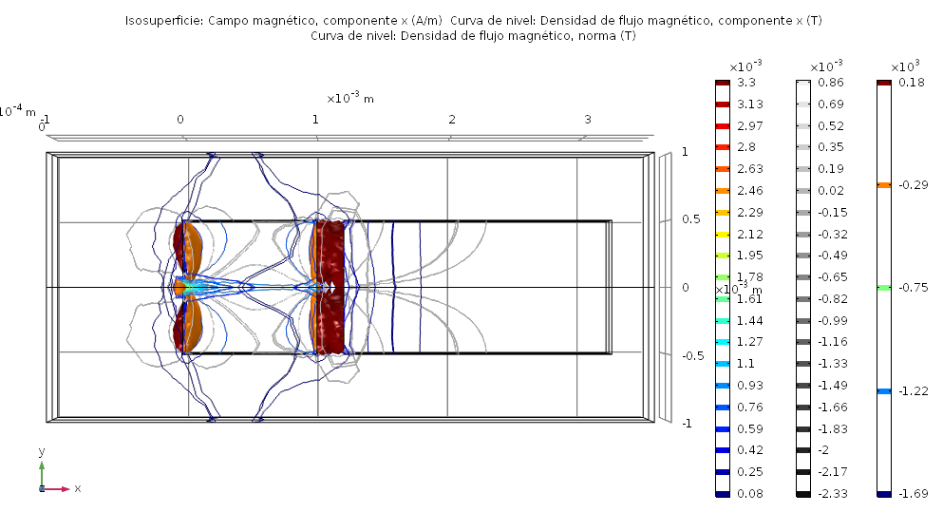
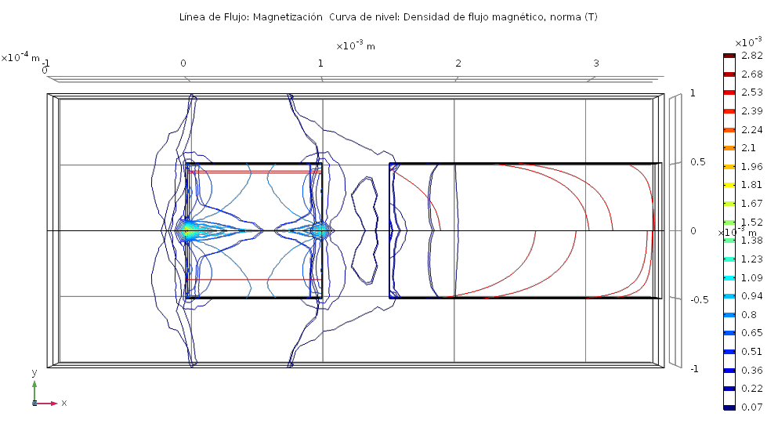
Magnet - Niquel

Slide 7
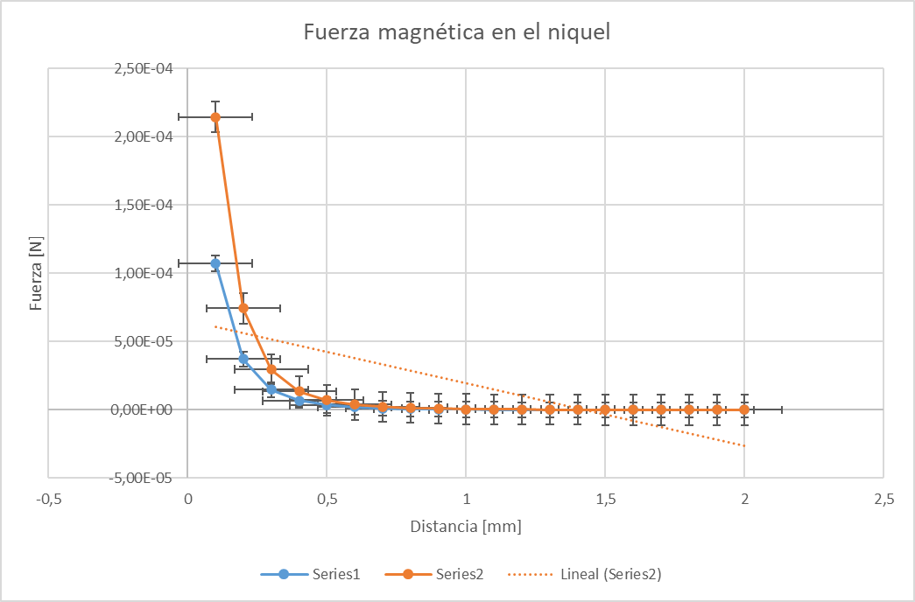

Slide 8
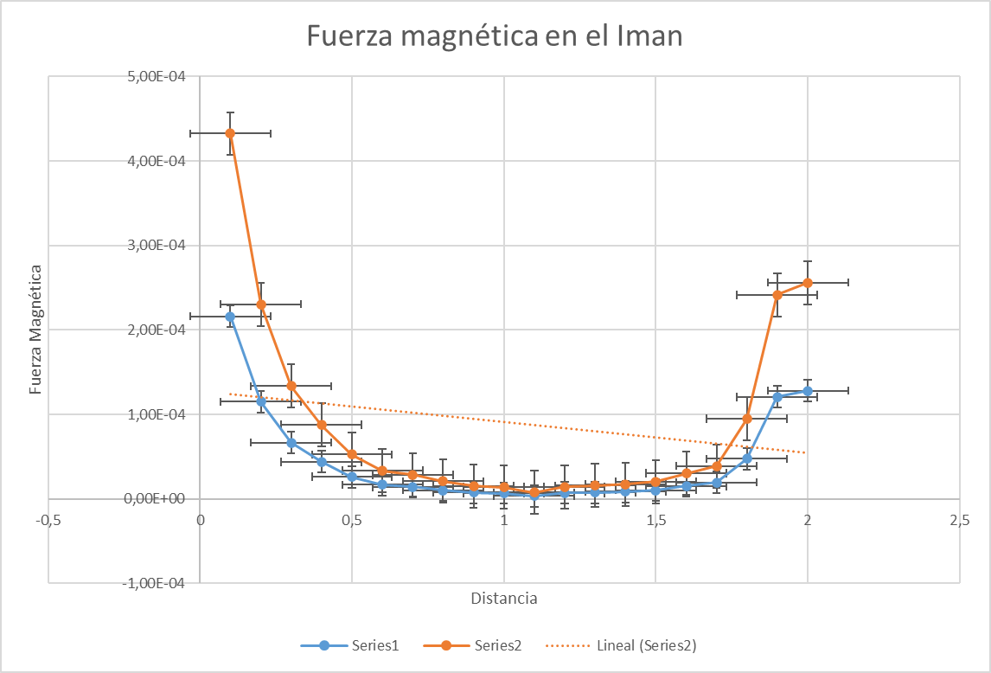

Slide 9
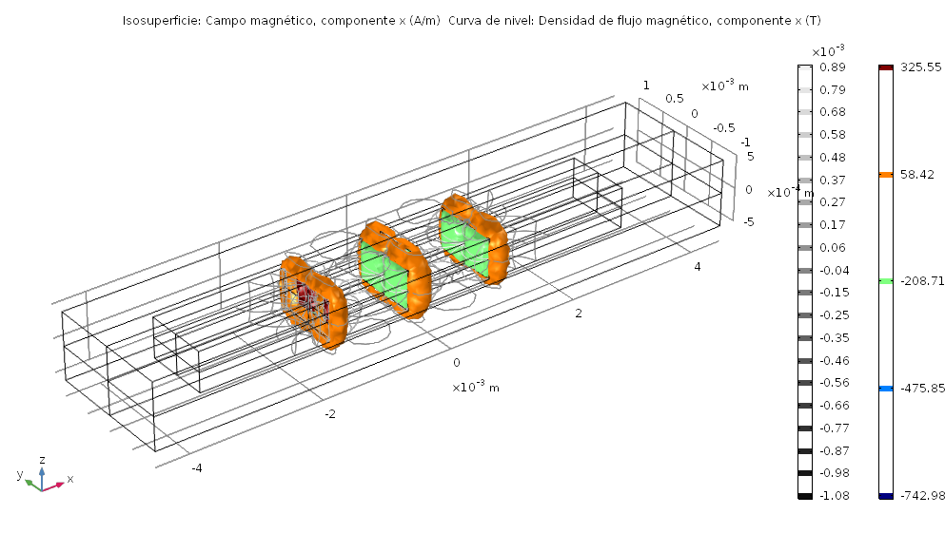

Slide 10
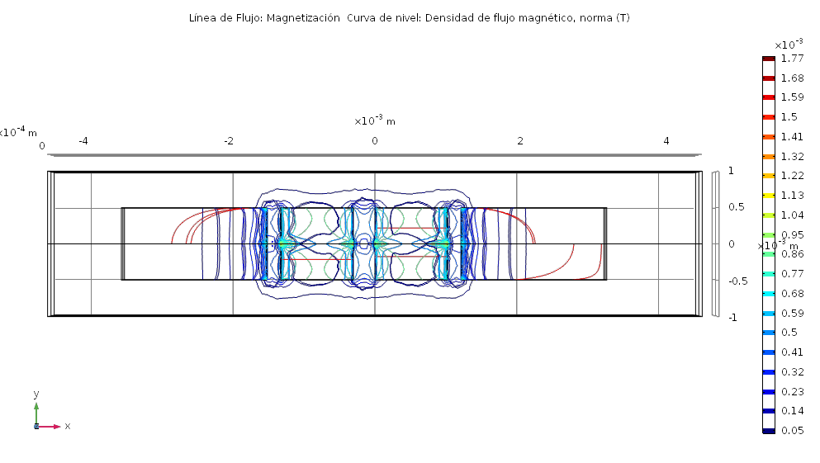

Slide 11
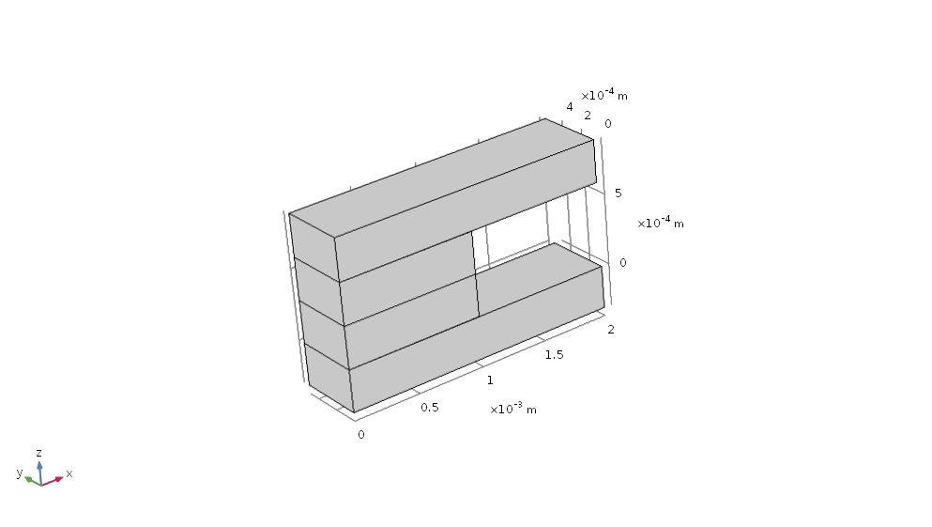

Slide 12
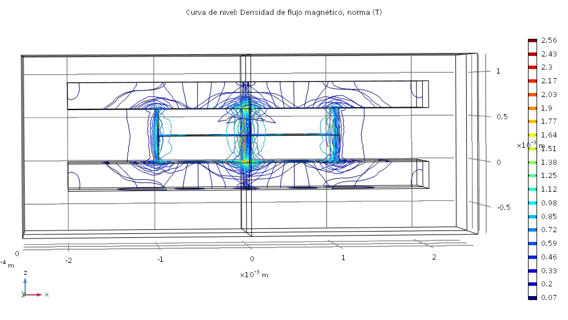

Slide 13
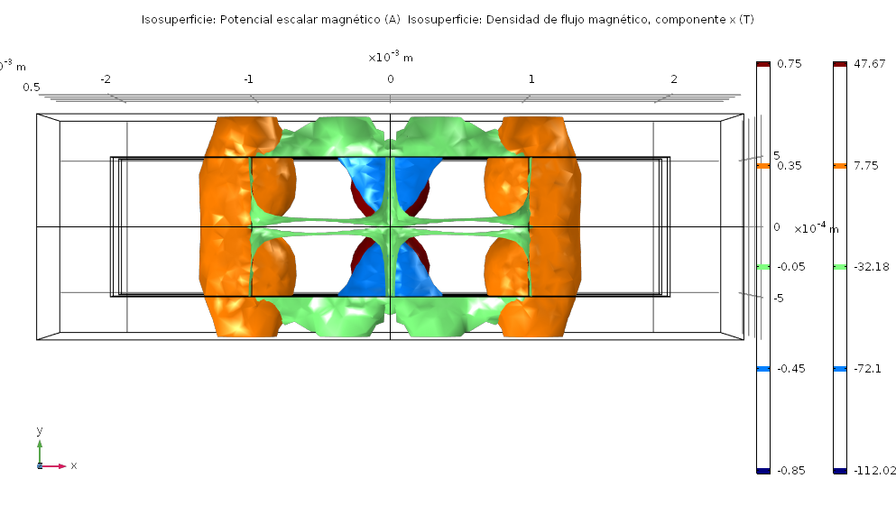

Slide 14
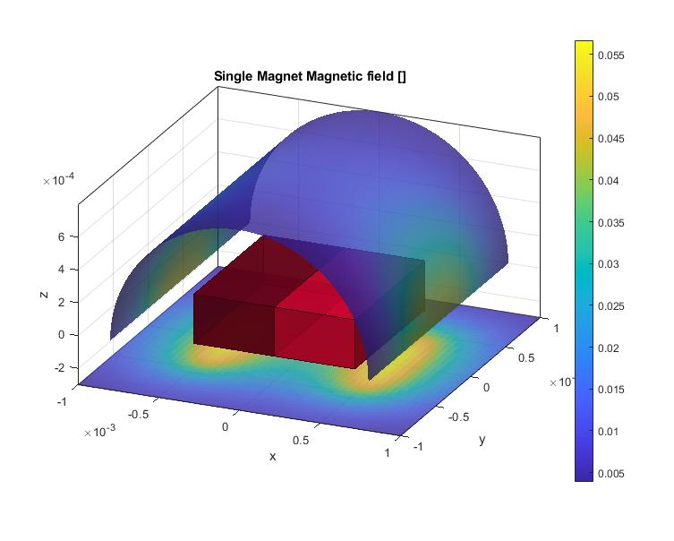
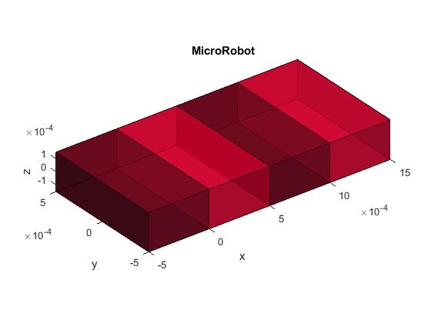
Matlab

Slide 15
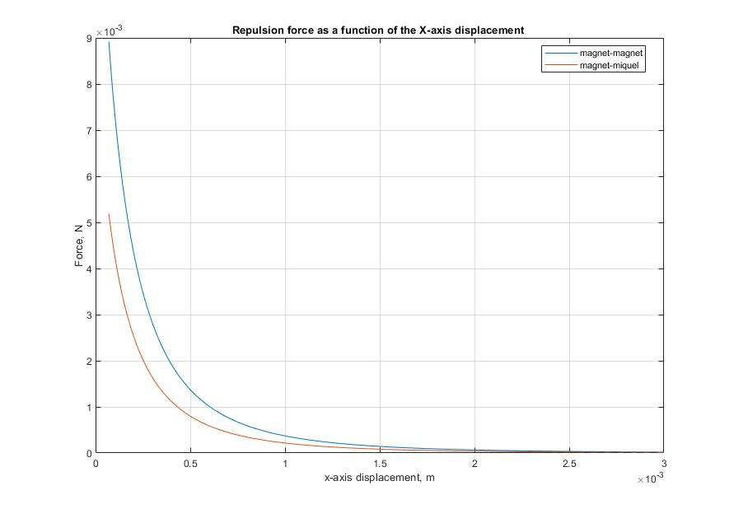
Magnet - Magnet
Magnet - Niquel

Slide 16
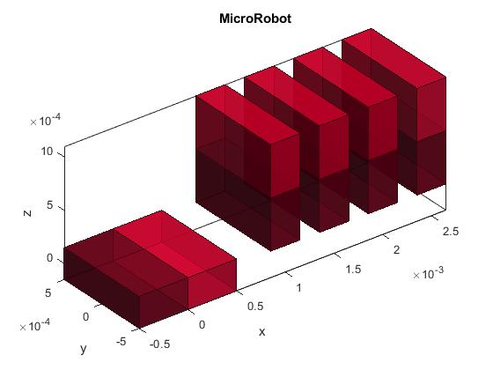
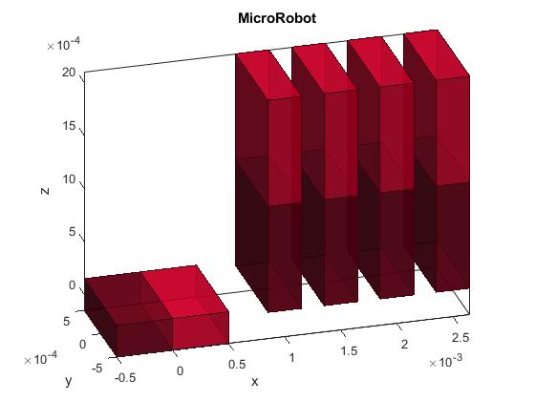

Slide 17
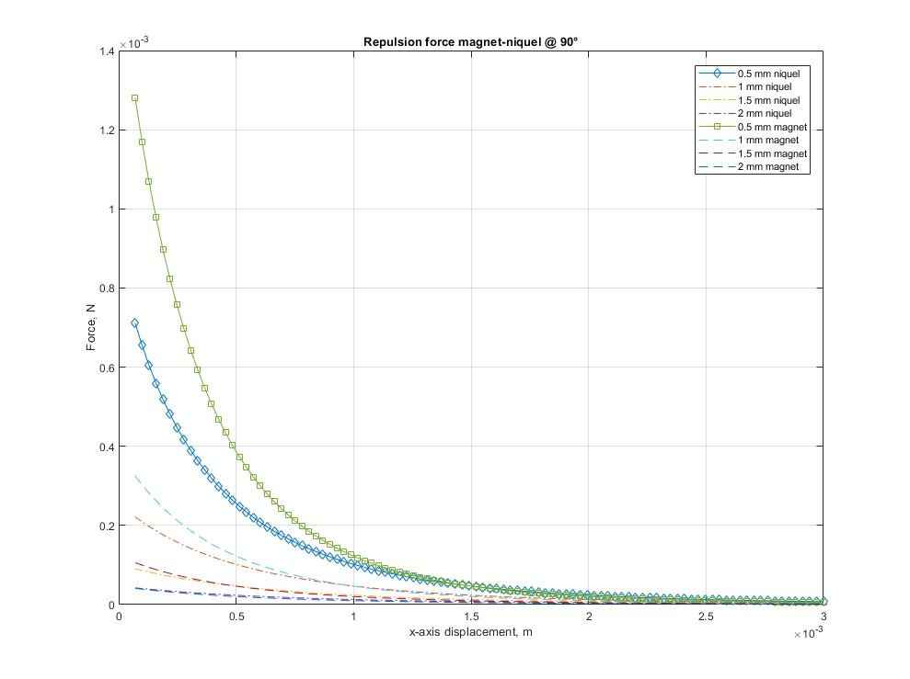

Slide 18
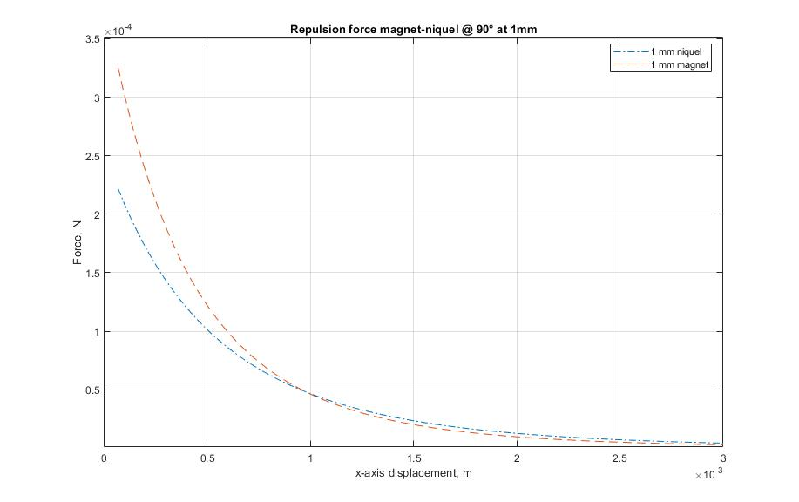

Slide 19
Future work

Slide 20


Thanks!
Any questions?

